Slide 1

NASA-MSFC Measurement of Cryogenic Propellant Fuel Levels
Team 516
1

Slide 2


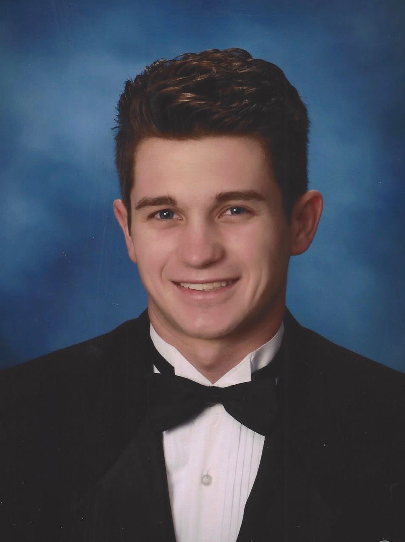
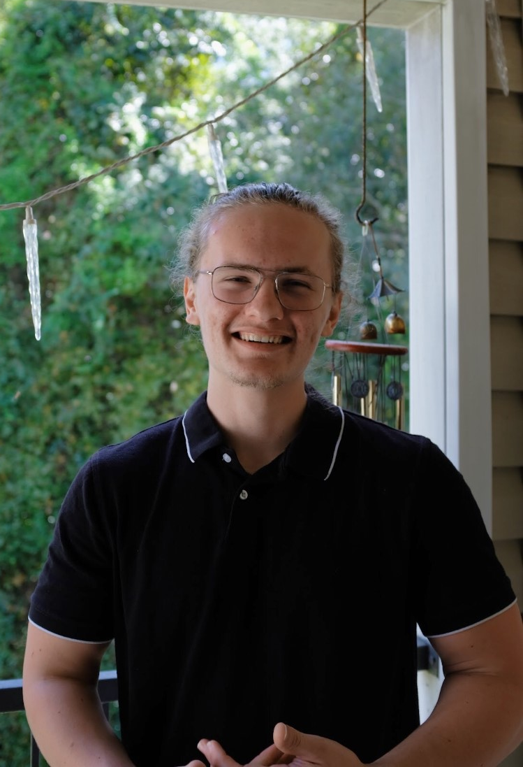
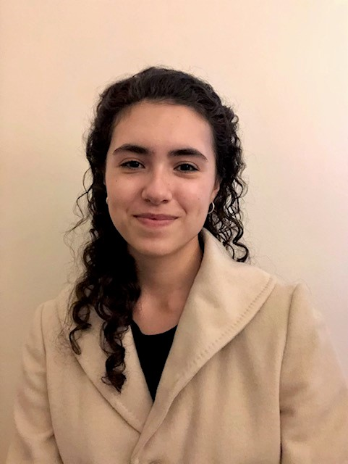


Team Introductions
Team Introductions
Zafer Jesri
Systems Engineer
Trevor Lay
Thermal Engineer
Bryson Peters
Fluids Engineer
Catherine Potts
Manufacturing Engineer
Dane Seal
Design Engineer
Bryson Peters

Slide 3
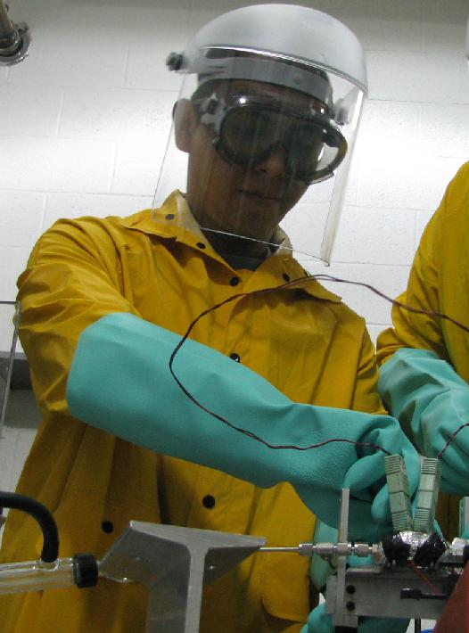
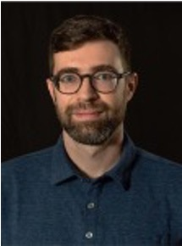
Sponsor and Advisor
Sponsor
National Aeronautics and Space Association
(NASA)
Engineering Mentor
Juan Valenzeula
Aerospace Engineer
Academic Advisor
Mark Vanderlaan, Ph.D.
Head of Hybrid and Cryogenics Operations
Bryson Peters

Slide 4

Project Objective
Measure cryogenic fluid levels in a storage tank under zero-gravity conditions and display the values onto an interface
Bryson Peters

Slide 5


Background
Cryogenic propellant used for space travel
Boils off very easily and gas bubbles mix with liquid fuel​
Bryson Peters
5

Slide 6
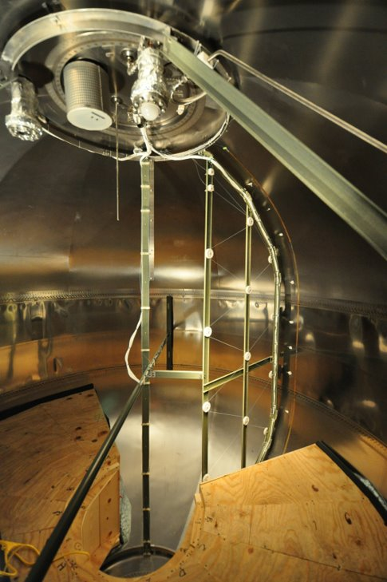
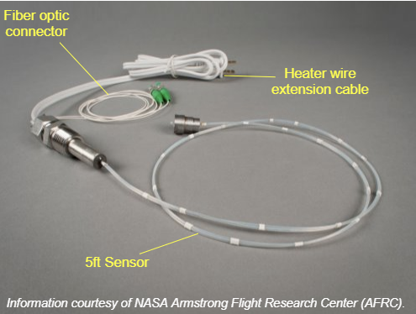
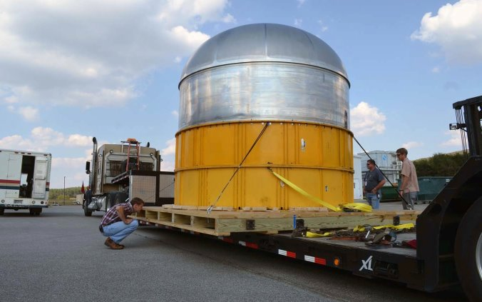
Background
Fiberoptic cable senses temperature of fluid in the tank
Cable gets brittle and snaps
Bryson Peters
6

Slide 7
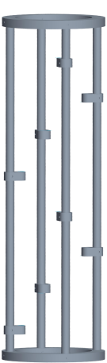
Background
Continuation of Team 514 from last year
Designed a helical support for the cable
Unable to test their design
Design by Team 514 (2021)
Bryson Peters
7

Slide 8

Project Scope and Goals
Design a support for fiberoptic cable
Develop program to analyze and display how much liquid fuel is in the tank
Not redesigning the cable or storage tank
Not constrained to a specific method of measurement
Cryo-tank
Gas
Liquid
Bryson Peters
8

Slide 9
Project Scope and Goals
Other goals include:
Testing last year's design
Performing a design analysis comparison (DAC)
Potentially explore other methods of mass gauging not dependent on a fiberoptic cable
Bryson Peters
9

Slide 10




Markets
Primary Market
Secondary Markets
Bryson Peters

Slide 11

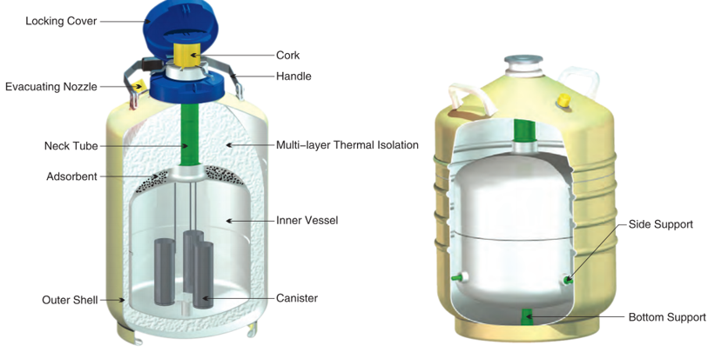
Assumptions
Fiberoptic Cable will be provided
Cryogenic testing will occur at MagLab utilizing a dewar
Cryogenic testing fluid is liquid nitrogen
Dane Seal

Slide 12
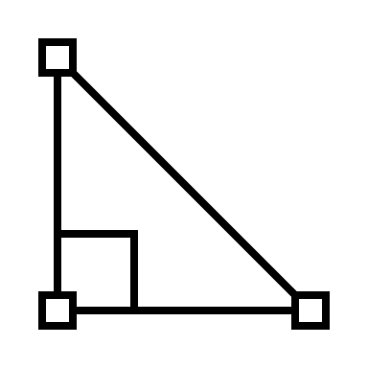




Customer Needs
Scalable Geometry
Withstands
Cryogenic Temperatures
Measures Fuel Levels
Interpret Sensor Readings
Dane Seal
12

Slide 13




Customer Needs
Scalable Geometry
Withstands
Cryogenic Temperatures
Measures Fuel Levels
Interpret Sensor Readings
Dane Seal
13

Slide 14

Customer Needs
Scalable Geometry
Withstands
Cryogenic Temperatures
Measures Fuel Levels
Interpret Sensor Readings
Dane Seal
14

Slide 15
Customer Needs
Scalable Geometry
Withstands
Cryogenic Temperatures
Measures Fuel Levels
Interpret Sensor Readings
Dane Seal
15

Slide 16
Customer Needs
Scalable Geometry
Withstands
Cryogenic Temperatures
Measures Fuel Levels
Interpret Sensor Readings
Dane Seal
16

Slide 17
Functional Decomposition
Structure
Sensors
Code
Power Source
Interface
Dane Seal
17

Slide 18
Functional Decomposition
Structure
Sensors
Code
Power Source
Interface
Dane Seal
18

Slide 19
Functional Decomposition
Structure
Sensors
Code
Power Source
Interface
Dane Seal
19

Slide 20
Functional Decomposition
Structure
Sensors
Code
Power Source
Interface
Dane Seal
20

Slide 21
Functional Decomposition
Structure
Sensors
Code
Power Source
Interface
Dane Seal
21

Slide 22
Functional Decomposition
Structure
Sensors
Code
Power Source
Interface
Dane Seal
22

Slide 23

Functional Decomposition
 | Structure | Sensors | Code | Power Source | Interface
Maintain Structural Integrity
Withstand Cryogenic Conditions
Distinguish if Fluid is Gas or Liquid
Relate Sensor Readings to Geometry of Structure
Lay Foundation for Sensor Layout
Allow Sensors to Span Access Wide Range of Tank
Display Fuel Level
Dane Seal
23

Slide 24







Future Work
Targets and Metrics
Concept Generation and Selection
Biweekly Sponsor Meetings
Risk Assessment
Bill of Materials
Testing of Materials
Spring Project Plan
Dane Seal
24

Slide 25

Conclusion
The objective of our project is to create a system capable of measuring cryogenic fluid levels in a storage tank under zero-gravity conditions.
By testing our own project and comparing it to the continuation of Team 514's project, we will be able to define and surmise the best possible solution.
Our project will need to have scalable geometry, withstand cryogenic conditions, is capable of accurately measuring fuel levels, and interpret sensor readings.
Our future work includes targets and metrics, concept generation and selection, sponsor and advisor meetings, and material testing.
Dane Seal
25

Slide 26
Functional Decomp Backup

Slide 27
Concept Selection Backup

Slide 28
Detailed Math Backup

Slide 29
Standard Shapes
Summary Box
Text box 1
Outlined Text Box

Slide 30




Approved Logos

Slide 31
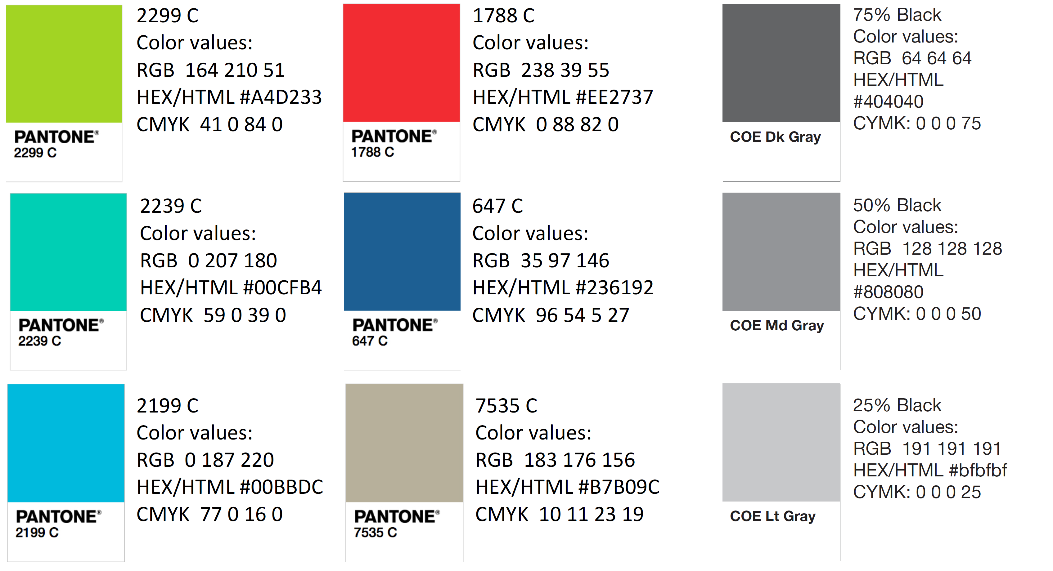
Color Palette

Slide 32
APA Tables
Category 1 | Category 2 | Category 3 | Category 4 | Category 5
Item 1
Item 2
Item 3
Item 4
 | Category 2 |  |  | Category 3
Category 1 | subcategory 1 | subcategory 2 |  | subcategory 1 | subcategory 2
Item 1
Item 2
Item 3
Item 4

